Slide 1
Presentation of Restaurant Management System
Group Member:
Md Sahrial Alam
Id: 17182103334
Md Ikbal Hasan
Id: 17182103317
Md Khairul Anam Mubin
Id:17182103286

Slide 2
Content
Introduction
Motivation
Objective
Technology
Methodologies
DFD
Use Case
E-R Diagram
Database Table
Modules
Limitation & Future Work
Conclusion

Slide 3
Introduction
There are lots of restaurantthat provide food to customer. They should maintain the restaurent smartly so that they reduce time and keep the all record. Thats why we will make a software management system to maintian restaurent properly

Slide 4
Motivation
The project aims to develop a system is for any type of document but nothing particular. This system is revolutionary to document processing. The uniqueness is being desktop based offline application and for general-purpose. This system available in a single computer. But it’s database can be access through local area network if database in a server computer. This system is developing by .Net Framework which followed the code first approach. To develop a database system which can easily store, retrieve and delete data.

Slide 5
Objective
Reduce time to maintain a restaurant.
Track of member records.
Calculate item note correctly.
Keep special member dio data.
Track of total sales.

Slide 6
Technology
There are some technology use in our system.
For Front End we used programming language c, c# and also used . Net Frame work
For Back End we used XAMPP software and MySQL quary.
Many Online tools for UML diagram

Slide 7
Methodologies
We used Agile method. In software development , agile approaches develop requirements and solution through the collaborative effort of self-organizing and cross-functional teams and their customer/end user. We think this is the perfect for our project . This is a small project and restaurant manager ,owner gives their feedback and those are helpful for make that project

Slide 8
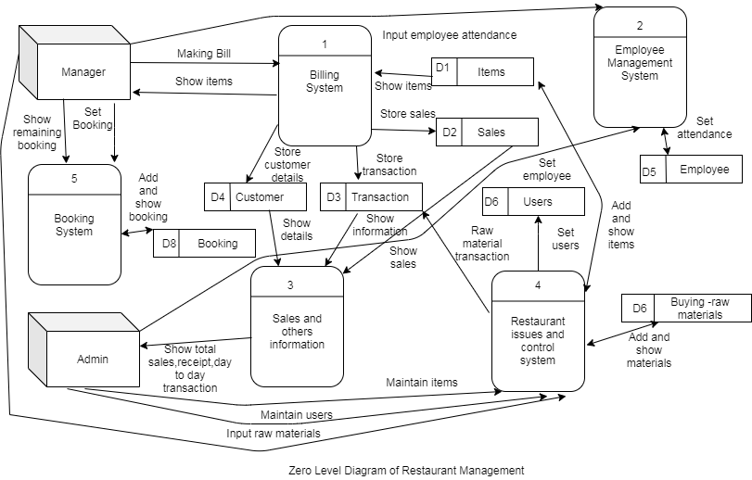
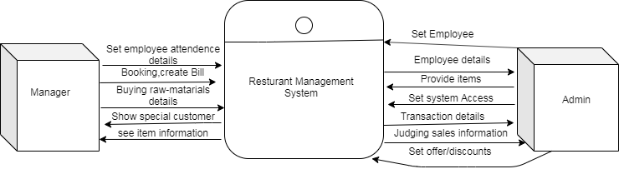
DFD

Slide 9
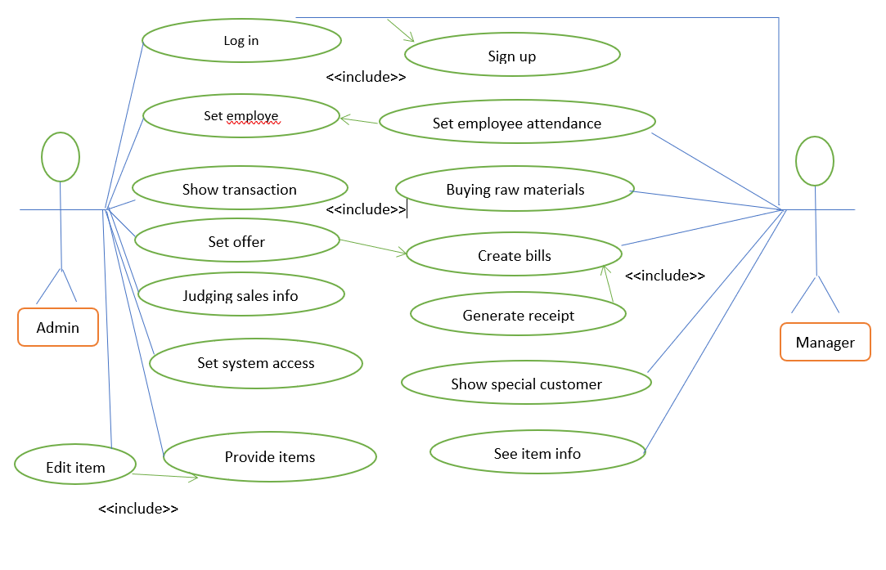
Use Case

Slide 10
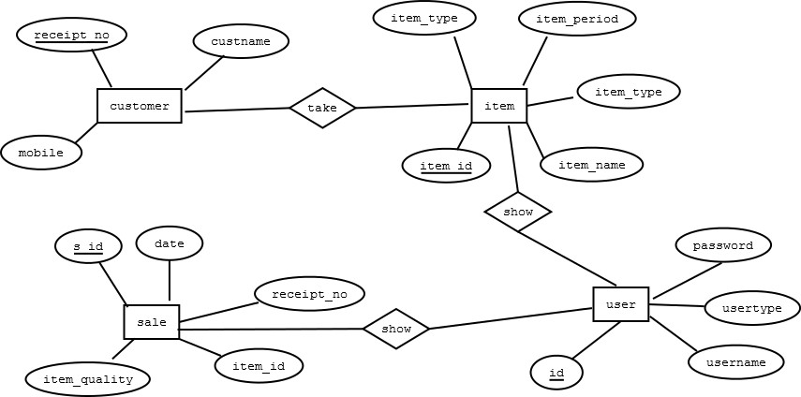
E-R Diagram

Slide 11
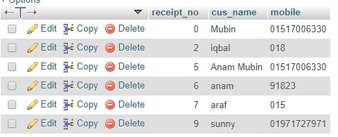
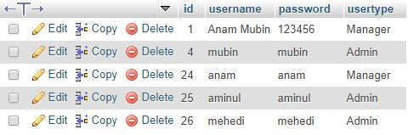
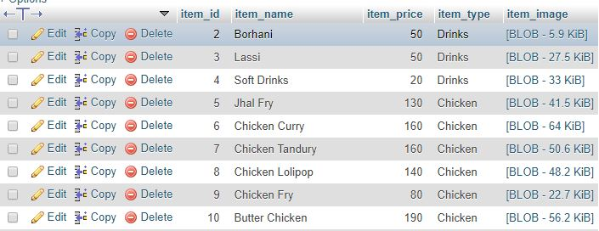
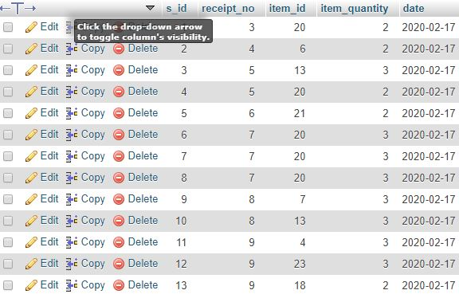
Database tables

Slide 12
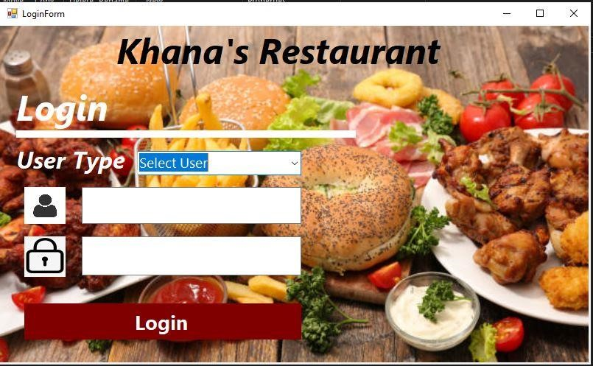
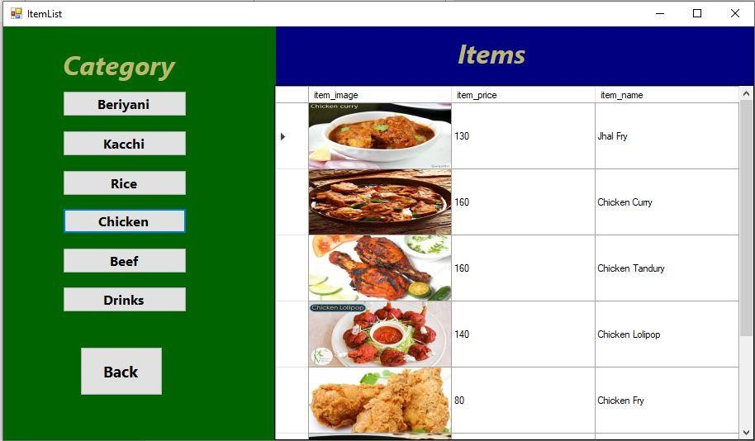
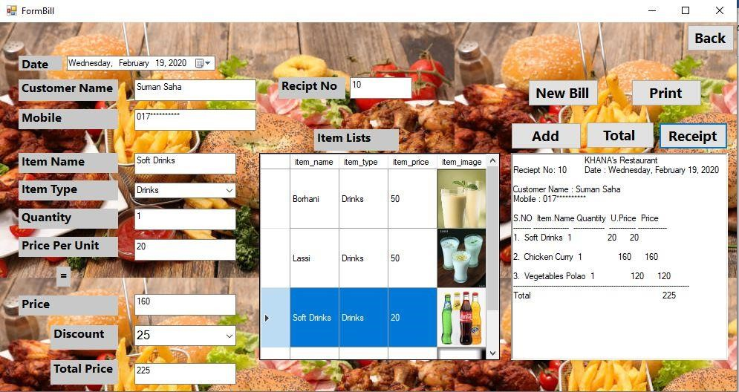
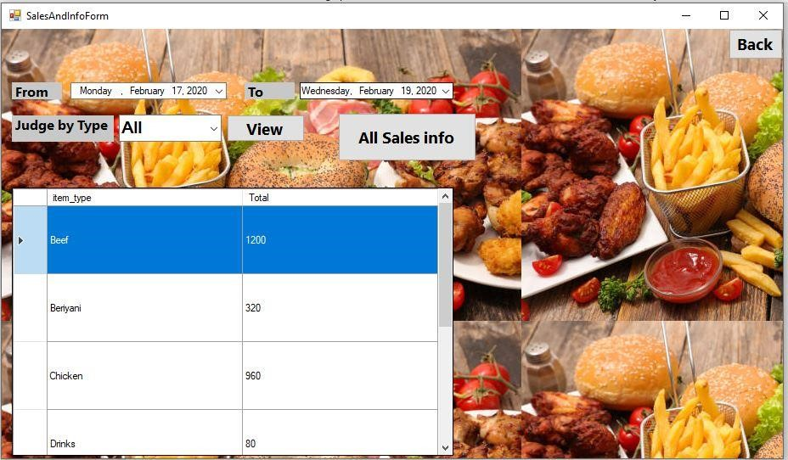
Modules

Slide 13
Limitation & Future Work
There are some drawbacks and limitations in this software as it is a beta release and under future development process.
Need to install first on computer before using.
Platform is not independent. So, it may not run on different operating systems like MacOS, Ubuntu, Linux.
Some minor bugs exist
Limited features, need to explore.
The project has a very fast scope in future. The project can be implemented on internet in future. Project can be updated in near future as and when requirement for the same arises, as it is very flexible in terms of expansion

Slide 14
Conclusion
Restaurent Management System has been proposed to be implemented to replace the manual system.
The main aim of this project is to computerization of all the process which happen restaurant. It is a database system for creating a selective retrived of information for subsequent analysis, manipulation and application

Slide 15
Thank You

